Slide 1

Guidelines
Kindly use the given template for submitting your project (Make a copy of the template)
One team is only required to submit one project/ppt.
The ideal size of the presentation should not be more than 10 slides.
You are welcome to add as many POCs and design concepts to support your project.
The project should be feasible and the team members should be capable enough, to come up with the prototype of the same idea, if required.
Solutions must include at least one Google technology.

Slide 2

Team Details
  Team name: “BCA UNDERGRAD”
  Team leader name: Iqlas Tharannum
  Problem Statement: Online Scam Prevention

Slide 3
Problem Statement:
Users frequently receive suspicious URLs, messages, and Emails through WhatsApp, SMS, and Emails
Non-technical users cannot easily identify phishing, scam, or fake links.
This leads to financial fraud, account compromise, and data theft.
Our Solution - SafeClick_AI
SafeClick-AI is a web application that analyses URSs, Messages, and Emails for phishing risk.
Users paste the content into the website and receive:
- Risk Score(Low/Medium/High)
- Clear Explaination using AI
- Safety advise
“Our solution focuses on prevention and awareness, not just detection.”

Slide 4
Opportunities:
  A. How different is it from any of the other existing ideas?
  Existing tools are technical and difficult for normal users.
  Most tools only say “safe” or “unsafe” without explanation.
  Our solution explains why something is risky in simple language.
  B. How does it solve the problem?
  Helps users verify links before clicking.
  Uses AI to explain risks clearly.
  Covers URLs, Messages, and Emails in one platform.
  “We target the moment of doubt, when users are unsure whether to click.”

Slide 5
List of features offered by our solution
URL risk analysis with score
Message phishing detection
              Email scam analysis
              Al-based explanation in simple language
              Categorization of risk (Low / Medium / High)
              Safety recommendations for users
              Fake domain and look-alike brand detection
              Shortened URL expansion and checking
              Urgency and emotional trigger detection
              Scam category identification (banking, prize, account warning)
              “Our key feature is explainability, not just detection”

Slide 6
Google Technologies used in the solution:
Google Chrome - Development, Debugging, Deployment and testing.
Chrome DevTools - Performance and network analysis.
Google Slides - Documentation and presentation.
Google Developer Community (GDG) - Mentorship, best practices, and innovation guidance.
Firebase- Website creation.
Google AI Studio- API keys.
Gemini- Integrated in website for our Aegis AI.
Vercel- For Web-development.
AI Integration:
Pre-trained Al model via API
Used for phishing explanation and risk interpretation
Converts technical risk into human-readable insights
“Our project is compatible with Google’s ecosystem.”

Slide 7
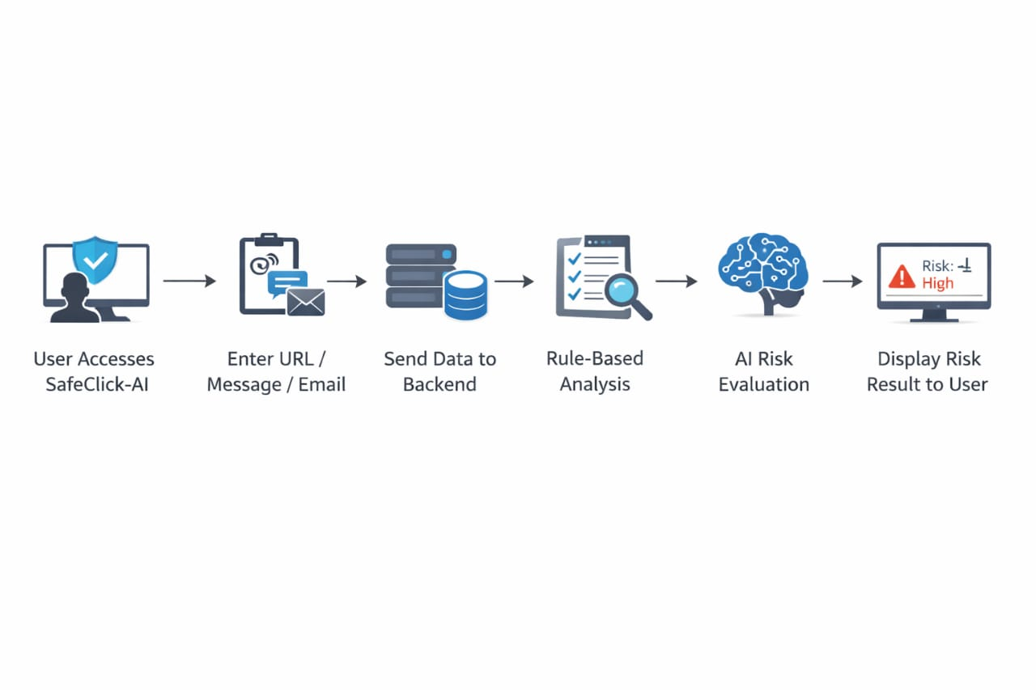
Use-case diagram
User opens SafeClick-AI website
User pastes URL/Message/Email
Frontend sends data to backend
Backend performs rule-based checks
AI generates explanation
Risk score and explanation shown to user
“The entire process is simple and user-friendly.”

Slide 8
Wireframe Description
The homepage displays the project name SafeClick-AI with a short tagline.
The main screen contains three tabs:
URL Analysis
Message Analysis
Email Analysis
Each tab opens a single input area where users can paste:
A suspicious URL
A message text
Or email content
Below the input area, an Analyze button is provided for submitting the data.
After analysis, a result section appears showing:
Risk Level (Low / Medium / High)
AI-generated explanation in simple language
Safety advice for the user
The layout is kept clean, minimal, and user-friendly to ensure ease of use for non-technical users.
“We separated UI, Logic, and AI clearly.”

Slide 9
Architecture
User Layer
Users interact with SafeClick-AI through a web browser
Supports analysis of URLs, messages, and emails
Frontend Layer
Built using HTML, CSS, and JavaScript
Collects user input and displays results
Sends analysis requests to the backend
Backend Layer
Developed using Python and Flask
Handles request routing and validation
Performs rule-based risk analysis
Prepares structured input for AI processing
AI Processing Layer
Uses a pre-trained AI model via Google Gemini API
Generates human-readable explanations
Interprets phishing and scam patterns
Response Layer
Backend combines rule-based score and AI explanation
Final risk level and safety advice sent to frontend
Results displayed clearly to the user

Slide 10
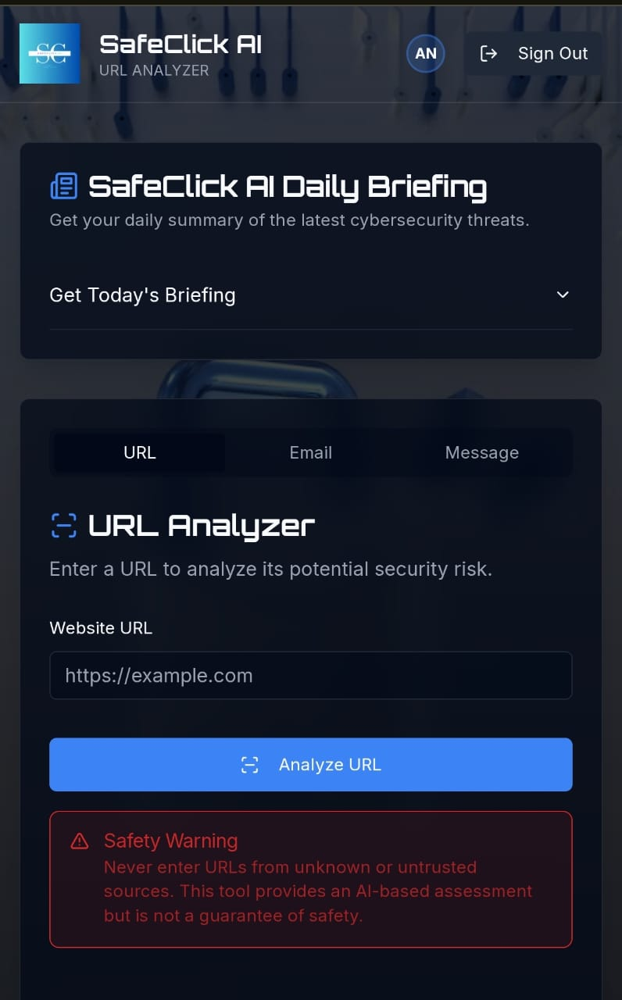
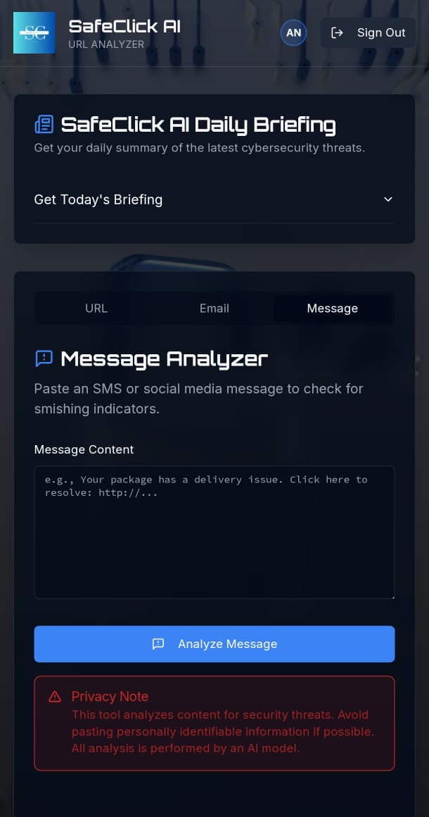
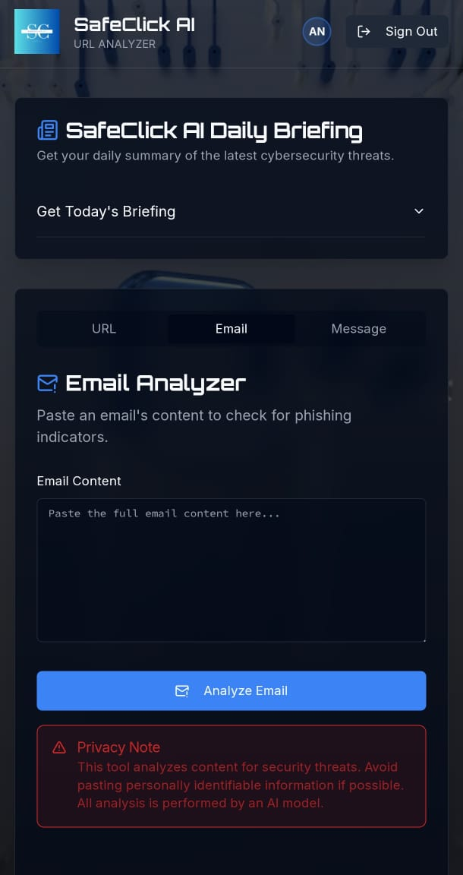
MVP Snapshots
URL Analysis
Risk score shown
Scam classification
Rule-based fallback visible
Message Analysis
Smishing keyword
AI Explaination
provided
Email Analysis
Phishing indicator highlighted
Safety recommendation provided

Slide 11
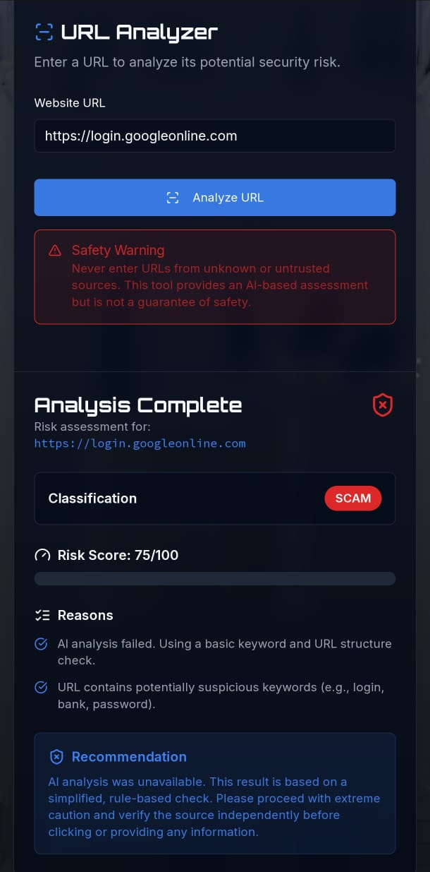
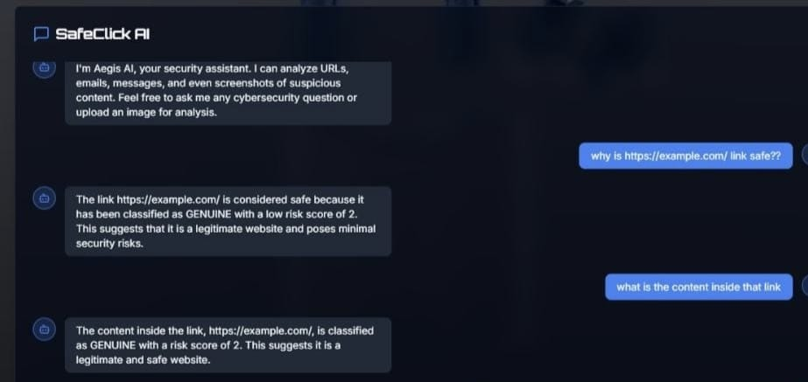
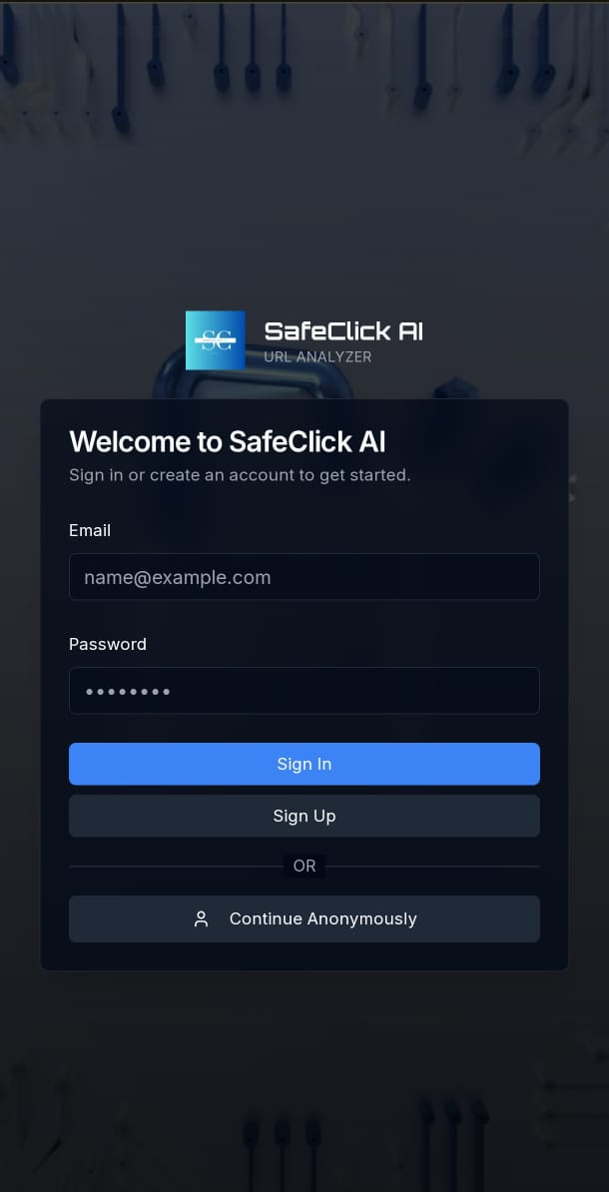
Risk Classification
Generates a risk score after analysis
Classifies content as Safe/Suspicious/Scam
AI-Based Recommendation
AI provides human-readable explainations
Highlights why the content may be phishing
User Authentication
Secure login interface to ensure authorization
Protects analysis history
Establishes trust within the platform

Slide 12
Future Enhancements
Browser extension for one-click analysis
Mobile app integration
WhatsApp / email plugin
Multi-language support
Advanced AI risk classification
Impact
Improved cyber awareness
Reduced phishing incidents
Safer digital behavior
“This project can grow into real-world cybersecurity tool”

Slide 13
Links provided:
GitHub Public Repository: https://github.com/iqlas13/SafeClick-AI
Demo Video Link (3 Minutes): https://drive.google.com/file/d/1Hzus_GYYDMvEz_rO25cbpmwRozYXEzhT/view?usp=drivesdk
MVP Link: https://safeclick-ftmmzvm16-iqlas-projects-b67f9d28.vercel.app/

Slide 14
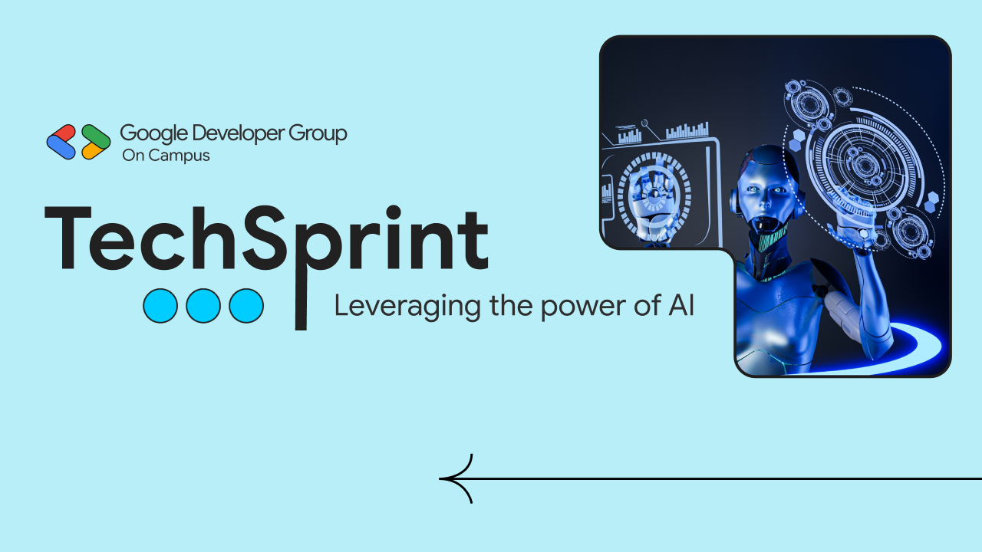
Thank you!

